Slide 1

Cover page
(Justina)

Slide 2
OUTLINE
INTRODUCTION
RECOMMENDATION
GENERAL figures
Deeper dive into HIGH-END TECH products
CONCLUSION

Slide 3
Should ENIAC sign a deal with MAGIST?
🇩🇪 ✈️ 🇧🇷 🟰 🤑💸⁉️
Notes:
Set expectations and meet them during the presentation (outline)

Slide 4
YES:
ONE YEAR TRIAL DEAL
Notes:
Tight dense text, hard to read.
Reorganize the slide.
Key words and bullet points.
Figures related to revenues are looking positive, and there is improvement through the years.
However, there is a problem with delivery time. The difference between estimated delivery time and actual delivery time is on average 11 days. This delay can cost the company some customers and therefore profit. It is important to note that delivery delay has decreased significantly throughout the years.
Our recommendation is to give Magist a one-year trial to see if they will do better on delivery time, and revisit the deal by the end of the trial.

Slide 5
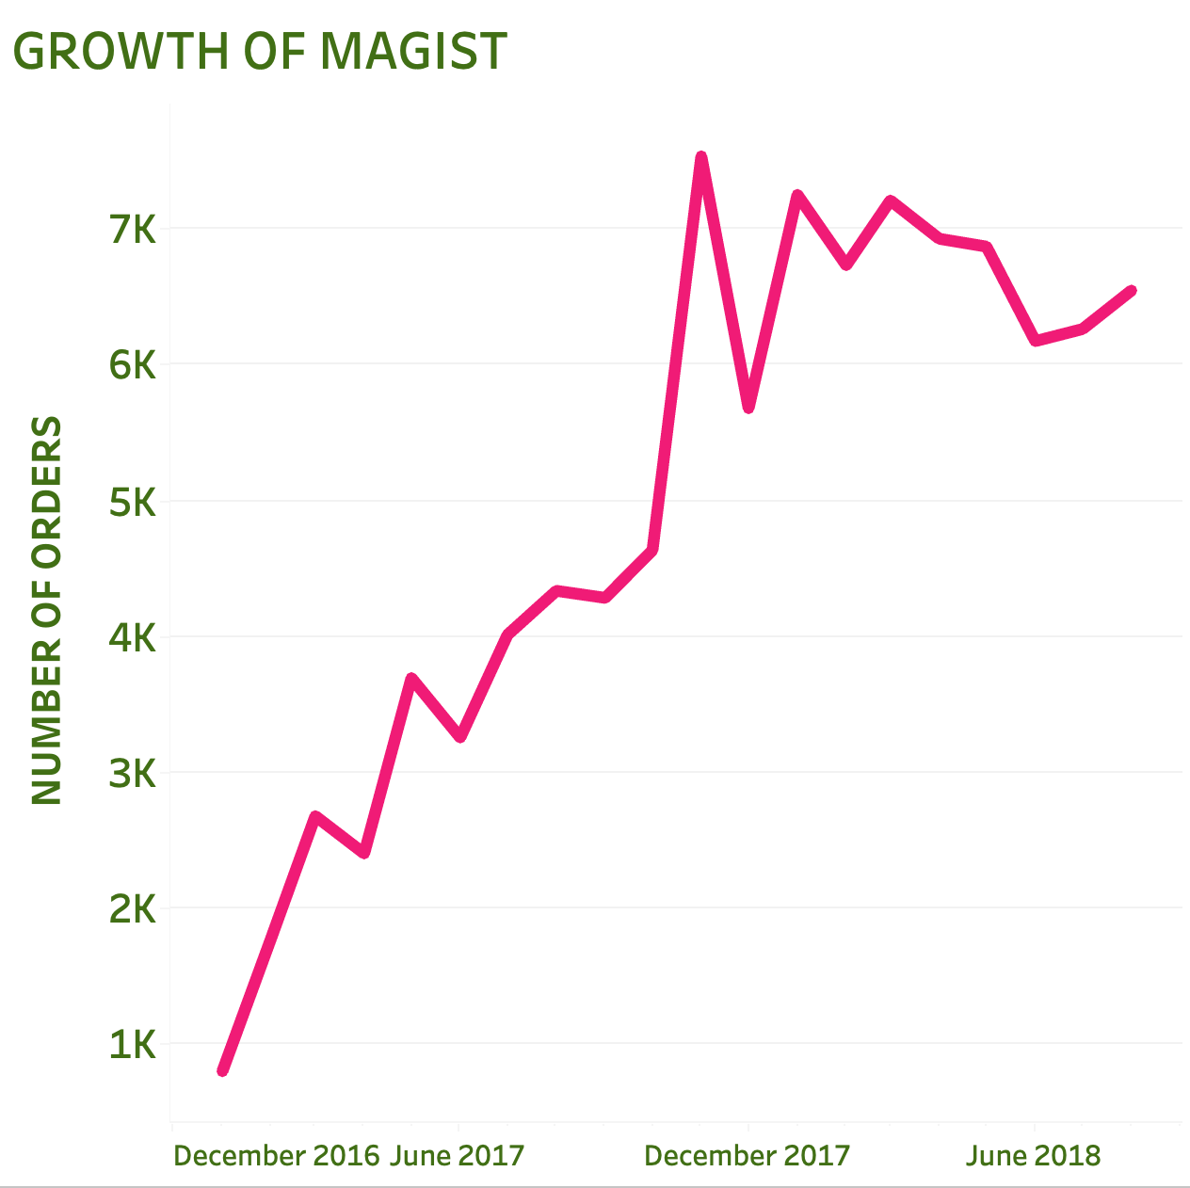
MAGIST’s POPULARITY GREW BY 19% (2017-2O18)
Notes:
Too simple, break it down monthly

Slide 6
General figures

Slide 7
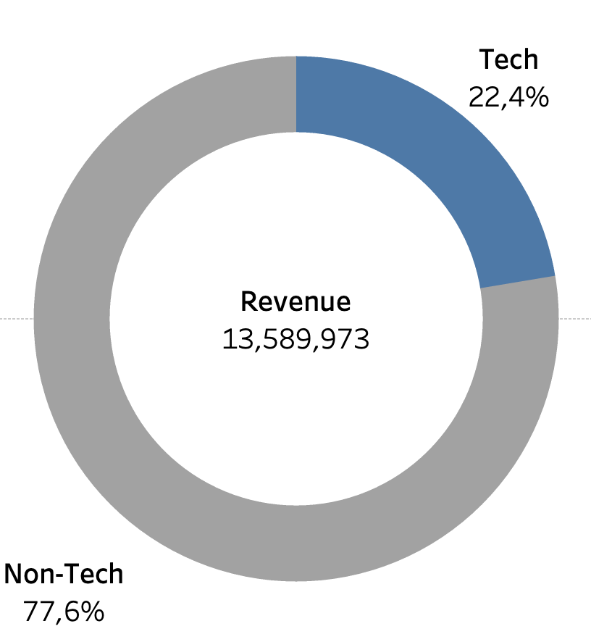
Almost 1/4 of the company’s total revenues comes from tech categories.
Notes:
We were curious about whether magist has experience with tech companies, so we looked into it and it shows ..

Slide 8
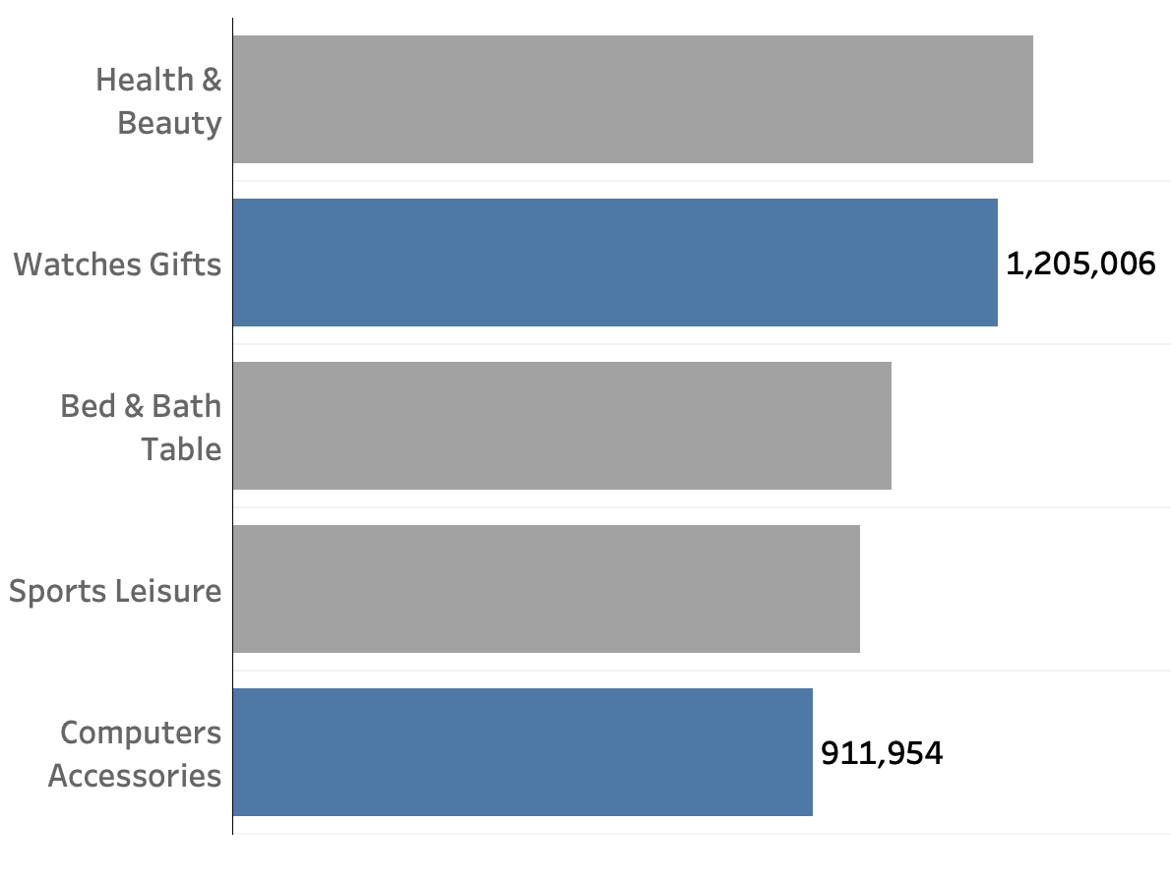
Out of the 5 best performing categories, two belong to tech.
Notes:
Text too small
Same method as the slide before
It might be irrelevant

Slide 9
Insights

Slide 10
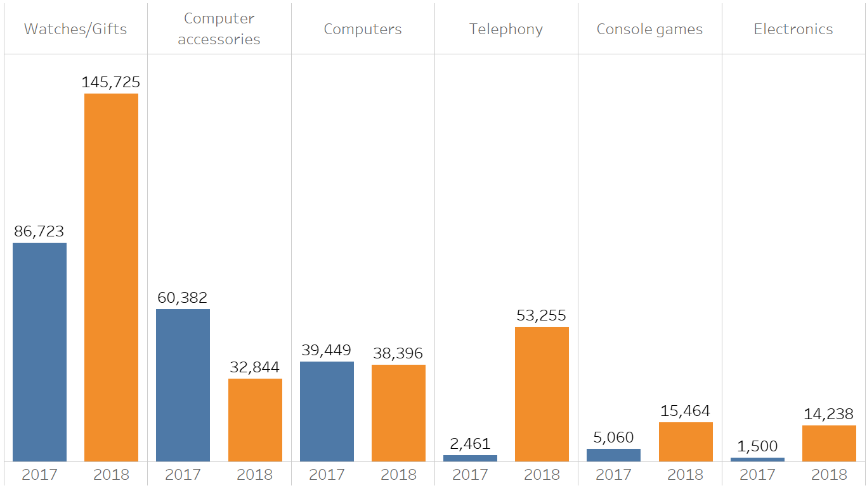
Increase of revenue of high end tech products from 2017 - 2018
Notes:
Hard to follow what we’re looking at and why, start with its relation to the decision to be relevant

Slide 11
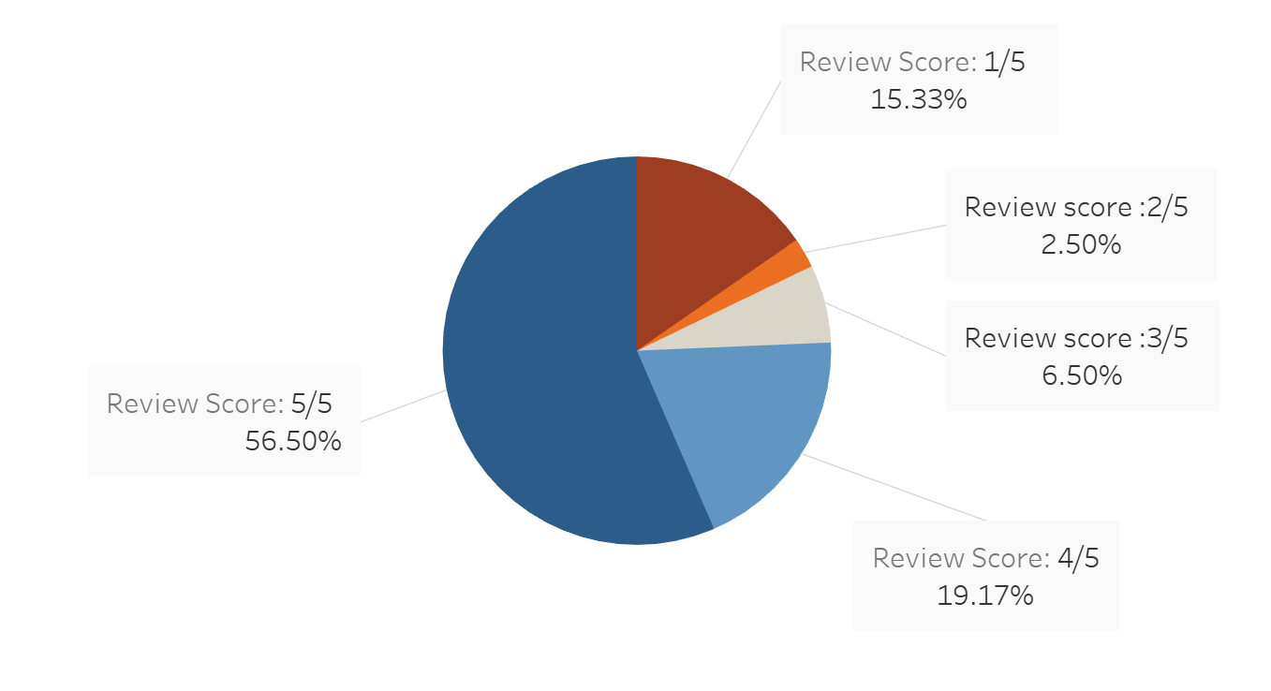
More than 75 % of customers are satisfied this their orders
Notes:
Text too small and not labeled
Growth would be better with line chart or bar chart

Slide 12
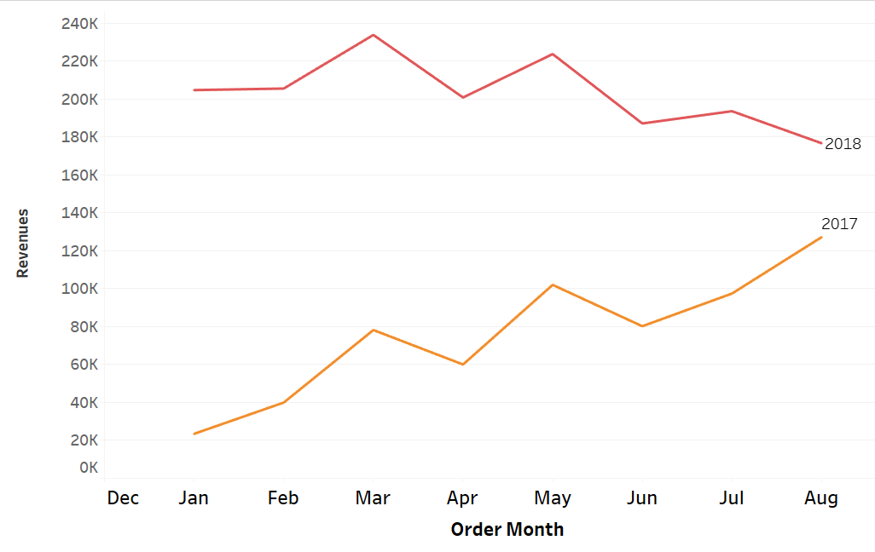
Revenues 2017 - 2018
Revenue
Growth in 2017
Decline in 2018
Notes:
We decided to dig deeper into sales months of our top 6 performing tech products. There is no question that revenues in 2018 are much higher than in 2017. However, looking at the pattern and the trends, we see a positive performance for the year 2017, with a noticeable decline for revenues in 2018.

Slide 13
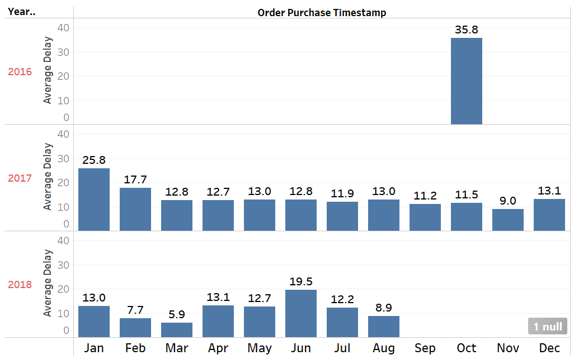
Delivery
Total average delay in delivery is 14 days
Notes:
Delivery time is important for our company as it can cost us customers. This is why we looked into figures related to the average delivery delay over the years. Magist is not showing much promise here with a total average of 14 days delay, but it is obvious that they are performing much better throughout the years.

Slide 14
Conclusions
SALES are improving
DELIVERY TIME is long, but improving
Notes:
MAGIST is a rapidly growing company in Brazil with a strong market presence in TECH sector
The company’s revenue from TECH is growing over years but recent patterns tell us to be careful.
MAGIST is improving its delivery services
More than 75% of customers are SATISFIED

Slide 15
Cover page
(Justina)
Thank you! 🚀

